Slide 1

Western University
High-Altitude Balloon (HAB) Experiment
A student led research project from the
Centre for Planetary Sciences and Exploration (CPSX)

Slide 2
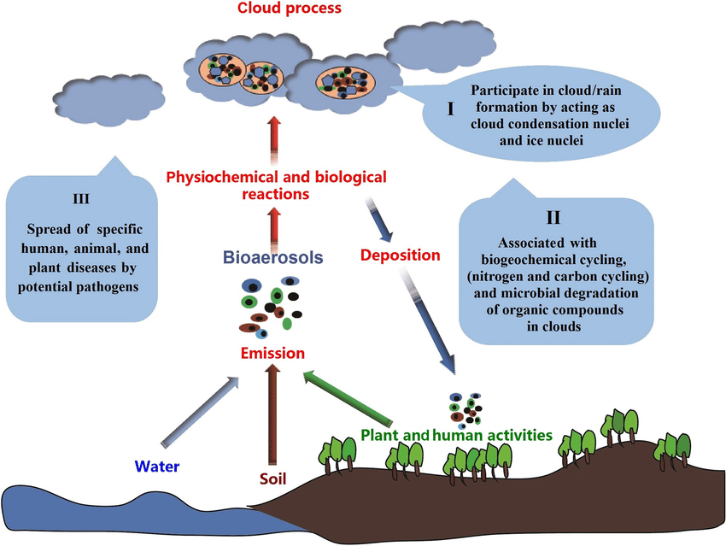
Determination of Vertical Bioaerosol Distribution
Bioaerosol Definition
Airborne particles that are biological in origin.
Significance
Impact on human health.
Transportation of allergens (pollen, fungi, etc)
Habitability of the atmosphere.
Microbial state: living, dead, dormant, etc.
Modified from Pöschl (2006)

Slide 3
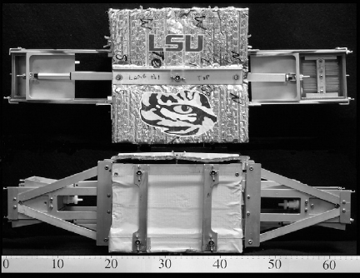
Previous Work (Bryan et al. 2014)
Sampling chambers
Objective
Determine the utility of their proposed method for sampling microbial aerosols via sounding balloon flights
Top View
Results
Sampled an average of 520 cells per individual rod
Side View
*Did not characterize the variety of cells in detail*
Bryan et al. 2014
Electronics Housing
Notes:
Bryan et al. (2014) developed a procedure for sampling microbial aerosols using a sounding balloon. They demonstrated that this method is capable of sampling microbial aerosols but did not determine the variation in the species sampled with altitidude.

Slide 4
Overall Project Objectives
1. Iterate the method for sampling microbial aerosols developed by Bryan et al. (2014).
Longer flight duration
Higher sampling resolution
Stratospheric balloon platform
2. Characterize the sampled microbial population at different altitudes during ascent
Notes:
Partially a concept study based on the work of Bryan et al. (2014) who first developed the balloon based method for sampling microbial aerosols. Our objective is to use this technique to sample microbial aerosols and then later characterize them and document changes with altitude

Slide 5
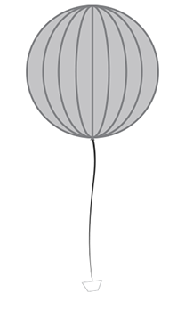
Threshold Objectives
Point 3
30 km (90 min)
1. Chambers sample at 3 points during ascension
2. One control chamber on board (blank sample)
3. One control chamber on the ground (ground sample)
4. Sampling chambers active for ~3-4 km
Point 2
20 km (60 min)
Point 1
10 km (30 min)
Point 0
0 km (Pre-flight ground sample)

Slide 6
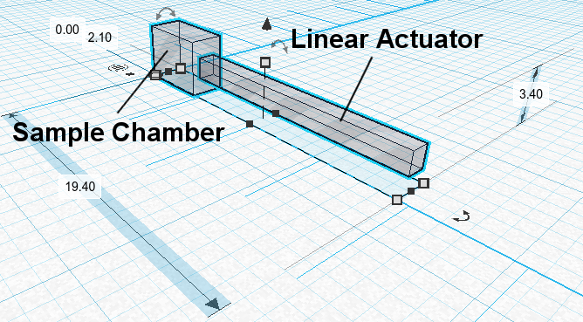
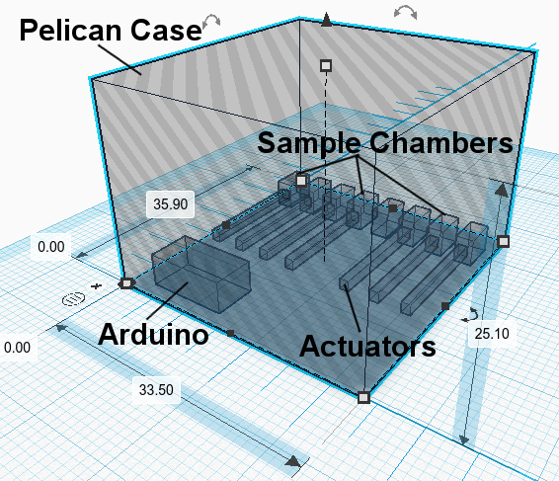
System Specifications: Payload Layout
Pelican Case w/ Sample Chambers and Arduino
8 Chambers total, 1 Control Chamber (won't open)
Extra head space will be filled with wiring, insulation, and any required support structures
Sample Chamber with Actuator
actuator shown in extended position

Slide 7
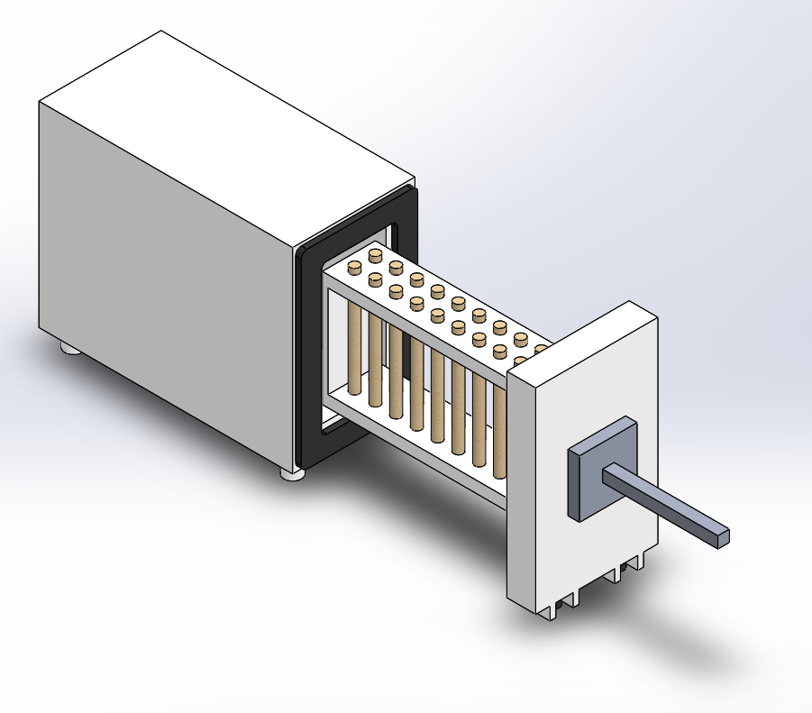
System Specifications: Sample Chamber
5mm thick Aluminum Body
Rubber o-ring-like seal
Holds 20 Rotorods
Passively exposed to the outside air
Held shut by actuator
Manufactured by local machine shop

Slide 8
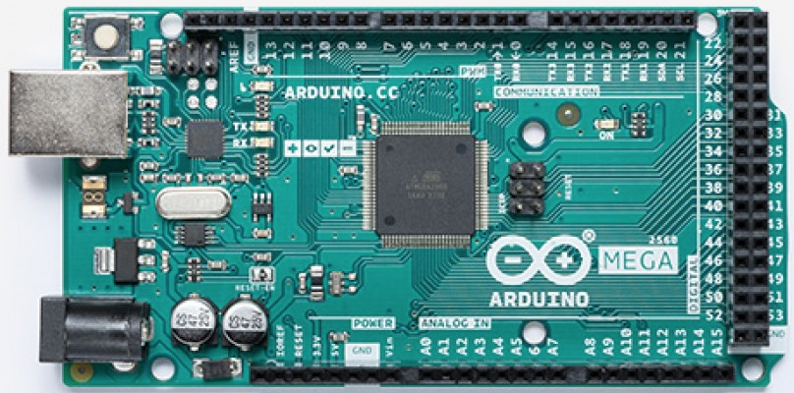
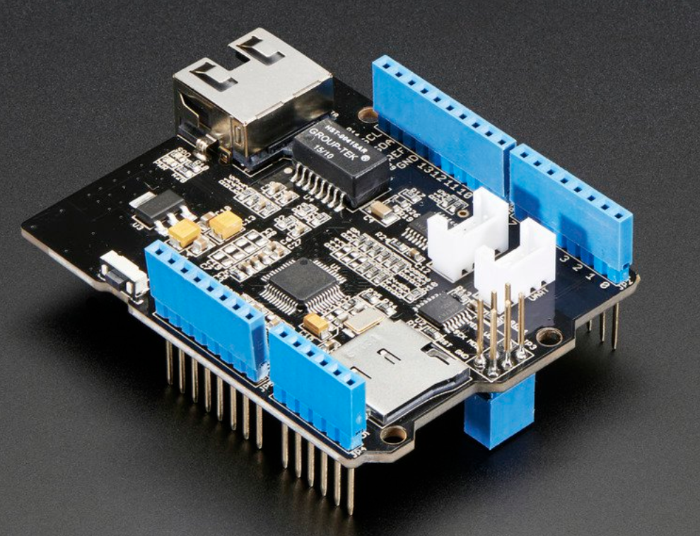
System Specifications: On-board Computer and Data Handling
Flight Computer: Arduino Mega 2560
Input Voltage: 12V @ ~25mA
54 GPIO pins
16 Analog Inputs
Operating Temperature: -40°C to 85°C
Ethernet Shield with W5500 Chipset
Input Voltage: 5V
Stacked on top of the Arduino
Data logging and Ethernet Interface
Contains microSD Card Slide

Slide 9
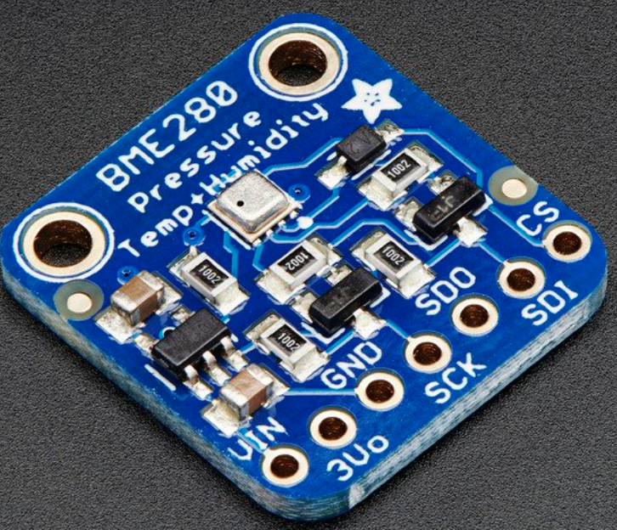
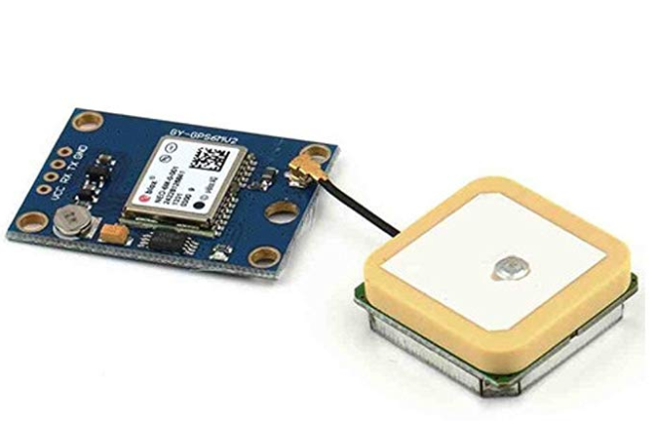
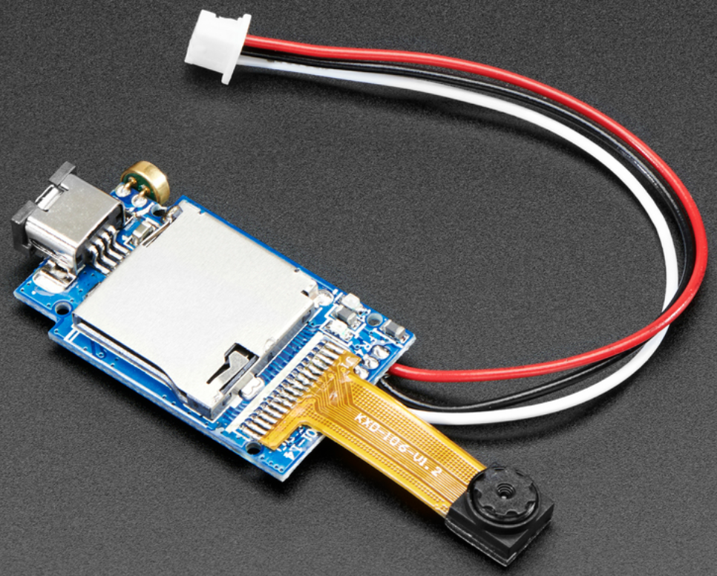
System Specifications: Sensors
BME 280 – Temperature, Humidity, Pressure Sensor
Interface: I2C or SPI
NEO-6M GPS Module
Interface: UART
Adafruit Mini Spy Camera
720p images or 480p Video
Interface: GPIO
Has onboard SD Card for picture/video storage
Input voltage: 3.7-5v

Slide 10
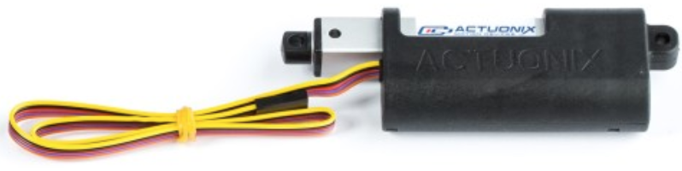
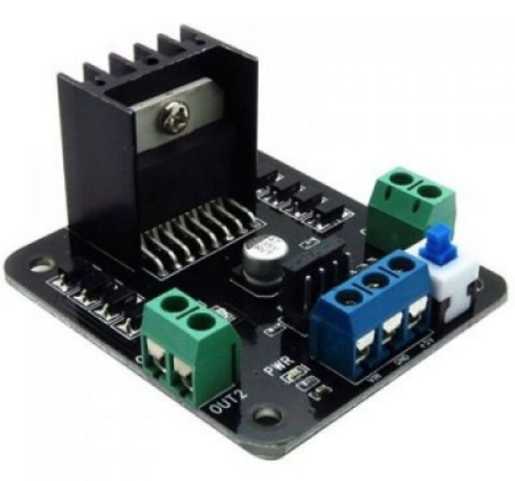
System Specifications: Actuators
Actuonix P16 Linear Actuator
50mm movement
256:1 Gear ratio
12V Input
Positional Feedback
Interface: H-Bridge Controller, Analogue Output to OBC, Vref from OBC
Operating Temperature: -10°C to 50°C
L298 Dual Channel H-Bridge Controller
Receives 12V input and outputs to two Actuators with direction control
Interface: GPIO, Vin from voltage regulator

Slide 11
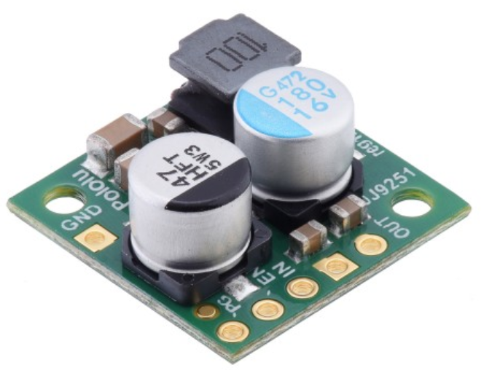

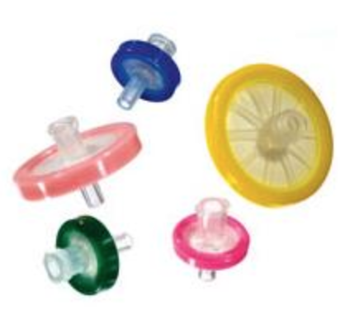
System Specifications: Essentials
MicroSD card for data logging on the ethernet shield
12V, 2.2A Voltage Regulator
Outputs Power to the H-Bridge Controllers, and the Flight Computer
Luer Lok with Syringe filters for pressure equalization

Slide 12
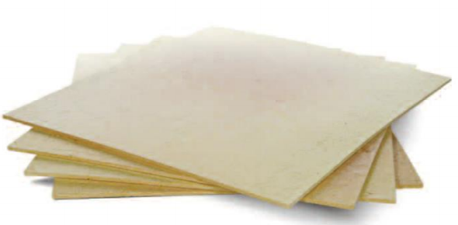
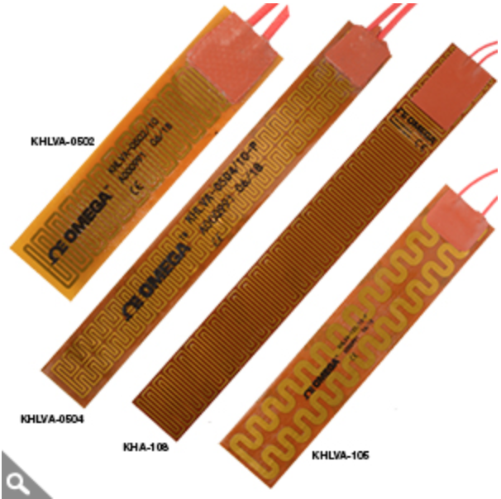
System Specifications: Thermal Control
Cerafelt Insulating Blanket for the Flight Computer and Linear actuators
Preliminarily selected for possible active control
Polyimide Insulated Flexible Heaters
Up to 10W/in^2 @ 28V input

Slide 13
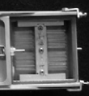
System Specifications: Sampling Method
Polystyrene sampling rods coated with silicone grease
22mm x 1.6mm cylinders
Sampling through impaction

Slide 14
Launch Day: Pre-Flight Procedures
Electronics
Check power connection to electronics
Ensure S.D. card is inserted
Check computer is logging:
GPS Coordinates (compare with gondola)
Temperature
Pressure
Ambient Humidity
Camera feed
Actuator position
Mechanics & Structure
Actuator Functionality (Run open / close sequence and confirm camera activation)
Structural integrity
Sampling Units
Load rods into sampling chamber. Two-three people in relatively clean environment, with gloves and masks to avoid contamination of rotorods

Slide 15
Launch Day: In-Flight Procedures
Point | Initiation Altitude | Flight Time
0 | 0 km | 0 min
1 | 5 km | 15 min
2 | 10 km | 30 min
3 | 15 km | 45 min
4 | 20 km | 60 min
5 | 25 km | 75 min
6 | 30 km | 90 min
7 | 34 km | 105 min (Long Duration)
F | 0 km | 9–12 hrs
7
Altitude (km)
6
5
4
3
2
1
0
F
Time (min)
Each Sample Chamber is assigned a target altitude. Chamber opens within 1-2km of target altitude
Sample 7 is active for the duration of extended level flight (error tolerance parameters required)
Camera and logging is triggered whenever actuator moves
All chambers are closed during descent phase –sampling only happens on ascent and level flight

Slide 16
Launch Day: Post-Flight Procedures
1. Assess payload damage
2. Retrieve S.D. card
3. Chambers stored in sealed container and kept in a cooler
4. Cooler ice is replenished during transport
5. Samples stored in freezer at Western

Slide 17
Post-Flight Microbiological Sampling Aims
Identify bacterial taxonomic groups
Compare taxonomic variation at varying altitudes
Assess the ecological and medical significance of isolated species

Slide 18
Post-Flight Microbiological Sampling
Sample Concentration
Archive sample
Culture based recovery sample
Non-culturable sample
Recovery of viable/culturable isolates
Identification via 16S V4 Sequencing
Taxonomic mapping using BLAST
Identification of non-culturable isolates
Identification via 16S V4 Sequencing
Bioinformatic analysis

Slide 19
Experiment Testing and Prototype Construction
Testing Before Launch
Thermal Test: Monitor the temperature inside cerafelt insulation wrapped computer when subjected to a cold (-25 °C) environment (freezer from the Laboratory for Stable Isotope Science at Western University).
Main concerns for this test
Identify internal and external temperature differential over insulation layer
Identify computer heat dissipation

Slide 20
Experiment Testing and Prototype Construction (cont.)
Eleven layers of insulation needed to maintain internal at 0 °C with –50 °C outside temperatures
Actual mission will need to use these 1.3 cm thick insulation layers wrapped around critical components (without heaters and not considering heat dissipation)
Five layers of insulation needed to maintain internal temperature at 0 °C in test chamber temperatures (-25 °C)
Using only five layers during testing allows better simulation of mission thermal environments and validation of insulation use

Slide 21
Experiment Testing and Prototype Construction (cont.)
Term | Symbol | Value | Units
Area | A | 0.045 | m²
Inside Temp | Ta | 271 | Kelvin
Outside Temp | Tb | 223 | Kelvin
Inside Conv | ha | 10.45 | W/m²K
Insulation Thickness | DelX | 0.143 | m
Insulation Conduction | k | 0.07 | W/mK
Outside Conv | hb | 27 | W/m²K
# Insulation Layers |  | 11
Heat Transfer | q | 1 | W
Term | Symbol | Value | Units
Area | A | 0.045 | m²
Inside Temp | Ta | 272 | Kelvin
Outside Temp | Tb | 248 | Kelvin
Inside Conv | ha | 10.45 | W/m²K
Insulation Thickness | DelX | 0.065 | m
Insulation Conduction | k | 0.07 | W/mK
Outside Conv | hb | 27 | W/m²K
# Insulation Layers |  | 5
Heat Transfer | q | 1 | W

Slide 22
Experiment Testing and Prototype Construction (cont.)
Additional Thermal Test
The Pelican case will be placed in the sun for six hours
Temperature sensors will measure the outer and inner surface temperatures of the case
The intent is to determine approximately how much heat is transferred through the thickness of the pelican case wall
Combining the knowledge from the two thermal tests will allow us to determine if additional thermal components like heaters are required

Slide 23
Experiment Testing and Prototype Construction (cont.)
Impact Test: Dropping a prototype unit with a parachute off a reasonable height to test the durability of the prototype.
Sample Transfer: Conduct procedural tests on transferring the sample rods in and out of the sample chambers.
Analytical Dry Run: Test analytical procedure using a sample rod and a medium.

Slide 24
Team Structure
Project Manager
Matthew Svensson
Assistant Manager
Alexis Pascual
Assistant Manager
Mohammed Chamma
Engineering
Alexis Pascual (Lead)
Bryan Southwell
Kelsey Doerksen
Nicole Devos
Rafael Nascimento de Aguiar
Stephen Amey
Jonathan Kissi-Ameyaw
Mohammed Chamma
Science
Bita Azad (Lead)
Gavin Tolometti
Nikol Posnov
Chimira Andres
Jahanvi Shah
Outreach
Gavin Tolometti (Lead)
CPSX Outreach Staff
Logistics
Chimira Andres (Lead)
Jahanvi Shah

Slide 25



Outreach (Promoting HAB and STEM)
Outreach Participation:
Members from the engineering and science team will manage a booth to promote the mission and collaborative partners SEDS and CSA.
Demonstrate the interdisciplinary aspect of student-led projects in planetary science.
Present the payload and the science objective.
Promote STEM to K-12 grade students.

Slide 26
Outreach (Current Plans)
High school participation requires additional insight from staff in the Faculty of Education and AFN interns.
On the 31st of March, the Outreach and Science team will be meeting with AFN interns to discuss best options for involving high school students and promoting the mission.
Interns will also help design STEM-based activities for outreach school visits to promote high altitude balloon missions.

Slide 27


Thank You

Slide 28
Novelty & Objectives
Objective
Concept testing the sample collection method proposed by Bryan et al. (2014).
Sample chambers only open for short period at set altitudes instead of constant exposure.
Samples collected at set altitudes will be identified during post-flight laboratory analysis.
Point 3
30 km (90 min)
Point 2
20 km (60 min)
Point 1
10 km (30 min)
Point 0
0 km (Pre-flight ground sample)

Slide 29
Threshold Objective
Point | Altitude | Approximate Time
0 | 0 km | 0 min
1 | 10 km | 30 min
2 | 20 km | 60 min
3 | 30 km | 90 min
F | 0 km | 9–12 hrs
Altitude (km)
3
2
1
0
F
Time (min)
Chambers sample at 3 points during ascension
One control chamber on board (blank sample)
One control chamber on the ground (ground sample)
Sampling chambers active for ~3-4 km

